Slide 1
CARDIAC MALPOSITIONS EMBRYOLOGICAL BASIS, NOMENCLATURE AND IMAGING
DR.ARAVIND KUMAR.K
SR CARDIOLOGY

Slide 2
REFERENCES:
Perloff’s Clinical Recognition of Congenital heart diseases 7th edition.
Moss and Adams’ Heart disease in infants, children and adolescents 10th edition.
Männer J. The anatomy of cardiac looping: a step towards the understanding of the morphogenesis of several forms of congenital cardiac malformations. Clin Anat. 2009 Jan;22(1):21-35. doi: 10.1002/ca.20652. PMID: 18661581.
Langman’s Medical Embryology 13th edition
Shiraishi I. Basic and comprehensive outlines of cardiovascular embryology and morphogenesis. J Pediatr Cardiol Card Surg. 2018;34:88-98.

Slide 3
INTRODUCTION
Cardiac malposition - abnormal or anomalous location of the heart.
It includes abnormalities of
Cardiac position (dextrocardia, mesocardia, levocardia),
The heterotaxy syndromes,
Pericardial defects, and
Ectopia cordis

Slide 4
KEY EVENTS IN DEVELOPMENT OF HEART
Formation of bilateral heart fields
Formation of the heart tube
Folding of the heart tube
Looping of the heart tube
Chamber specification and compaction

Slide 5
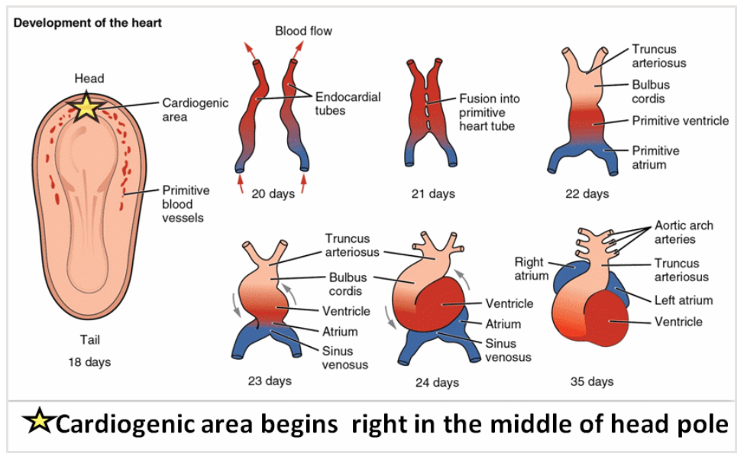

Slide 6
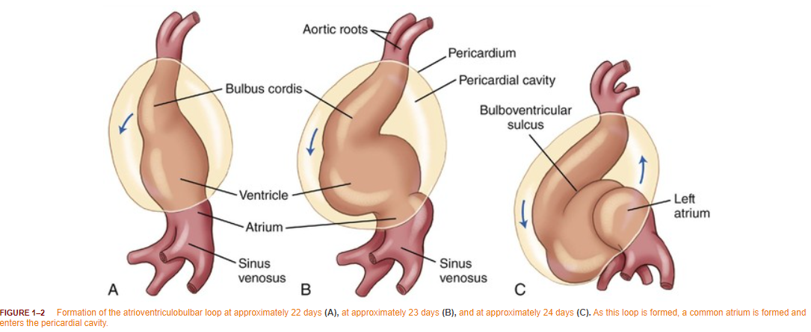
KEY EVENTS IN LOOPING
The straight heart tube elongates with simultaneous growth in the bulbus cordis and primitive ventricle.
This forces the heart to bend ventrally and rotate to the right, forming a C-shaped loop with convex side situated on the right.

Slide 7
The ventricular bend moves caudally and the distance between the outflow and inflow tracts diminishes.
Atrium and sinus venosus become dorsal to the heart loop
The atrial and outflow poles converge and myocardial cells are added, forming the truncus arteriosus

Slide 9
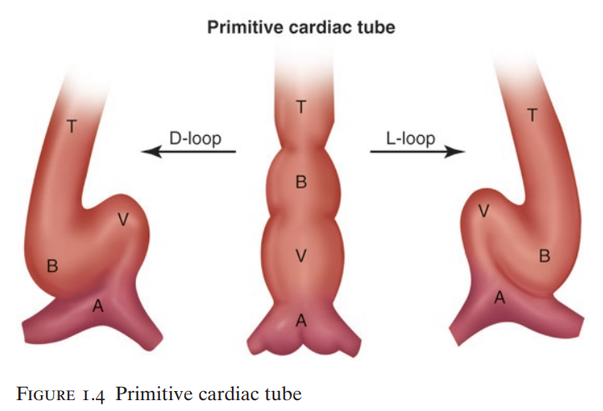

Slide 10
NOMENCLATURE
Cardiac position: Refers to the intrathoracic location of the heart as left-sided (levocardia), right-sided (dextrocardia), or midline (mesocardia).
Cardiac malposition: An abnormal intrathoracic location of the heart or a location that is abnormal (inappropriate) relative to the position (situs) of the abdominal viscera.
Situs: Site or position. Solitus: Usual or normal. Situs solitus: Normal position
Situs inversus: Opposite or reverse of normal
Ambiguus: Uncertain, indeterminant. Situs ambiguus: Uncertain, indeterminant, or ambiguous position.

Slide 11
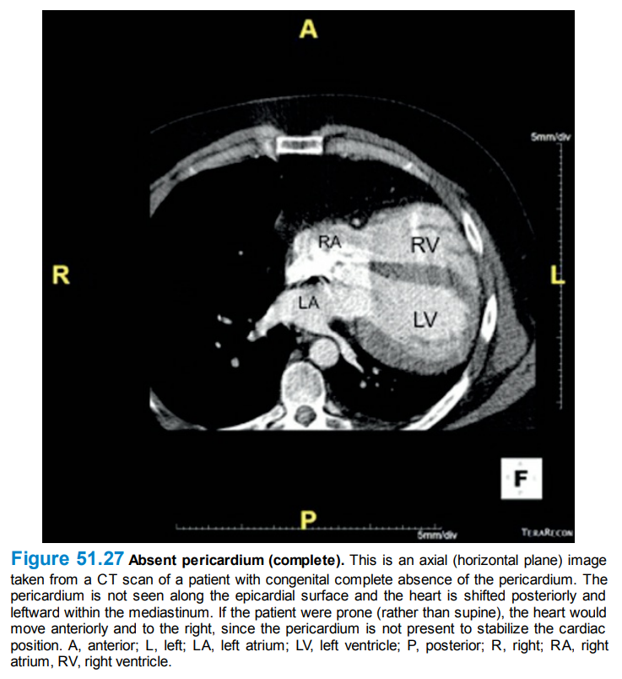
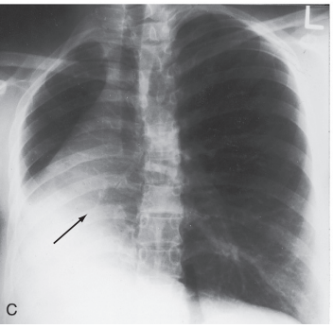
Cardiac displacement:
A secondary shift in intrathoracic cardiac position in response to eventration of a hemidiaphragm, agenesis of a lung(C) or congenital complete absence of the pericardium

Slide 12
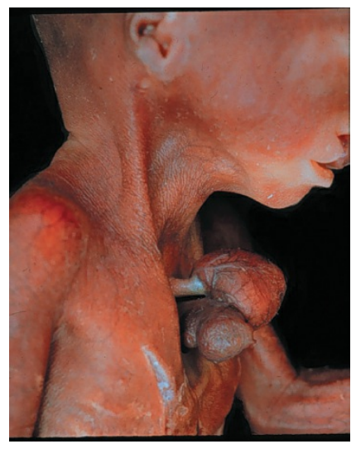
Ectopia cordis: (Gr) ektopos displaced. Extrathoracic location of the heart

Slide 13
Chamber designations: Right and left refer to morphology rather than position, as right or left atrium and right or left ventricle.
Great arterial designations: Ascending aorta and pulmonary trunk are defined in terms of their ventricular alignments or their spatial relations to each other.

Slide 14
Heterotaxy: (Gr) heteros = other, different; taxis = arrangement.
Isomerism: (Gr) isos = equal; meros = part. Refers to the morphologic similarity of bilateral structures that are normally dissimilar, such as right and left atrial appendages, right and left bronchi, and right and left lungs

Slide 15
Ventricular loop: The right or left bend (loop) that forms in the straight heart tube of the embryo.
d-Loop: The normal rightward (dextro = d) bend in the embryonic heart tube.
The d-loop designation - sinus or inflow portion of the morphologic right ventricle lies to the right of the morphologic left ventricle.
The l-loop(levo) - the sinus or inflow portion of the morphologic right ventricle lies to the left of the morphologic left ventricle.

Slide 16
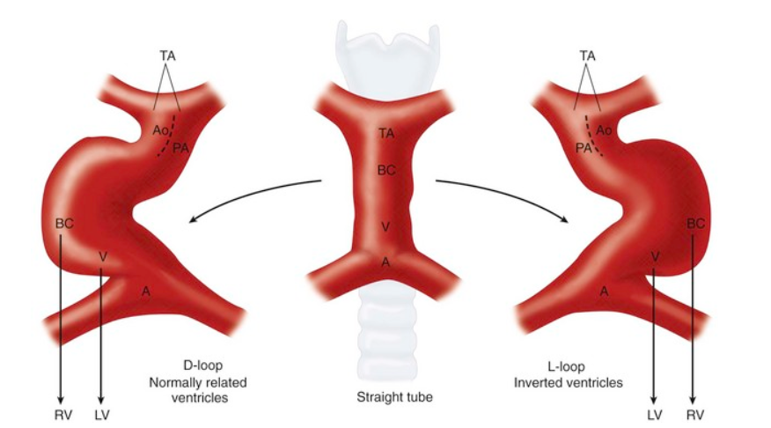
Concordant loop:
a ventricular loop that agrees with (is appropriate for) the visceroatrial situs (i.e., d-loop in situs solitus, l-loop in situs inversus).

Slide 17
TRANSPOSITION
MALPOSITION
Each great artery is connected to a morphologically discordant ventricle (ventriculoarterial discordance).
The aorta arises from a morphologic right ventricle, and the pulmonary trunk arises from a morphologic left ventricle.
Refers to abnormal spatial relationships of the aorta and the pulmonary trunk to each other in either the lateral or the anteroposterior plane
Ventriculo/great arterial concordance is maintained

Slide 18
Atrioventricular discordance:
Morphologic right atrium →morphologic left ventricle via a morphologic mitral valve (RA-LV via MV)
Morphologic left atrium →morphologic right ventricle via a morphologic tricuspid valve (LA-RV via TV)
Ventriculo-arterial discordance
Morphologic right ventricle →aorta (RV-Ao)
Morphologic left ventricle →pulmonary trunk (LV-PA)

Slide 19
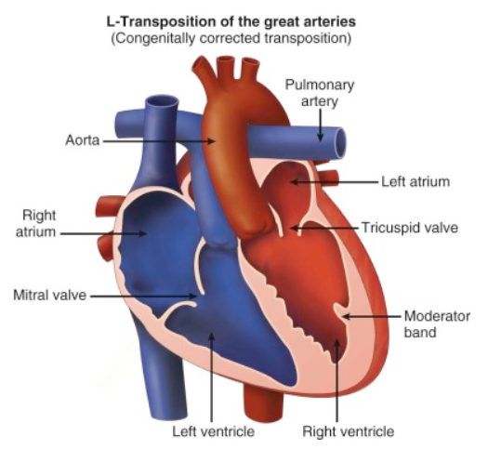
CONGENITALLY CORRECTED TRANSPOSITION
Double discordance (atrioventricular and ventriculoarterial) resulting in physiologic correction
Right atrial blood reaches the pulmonary artery through a morphologic left ventricle
Left atrial blood reaches the aorta through a morphologic right ventricle

Slide 20
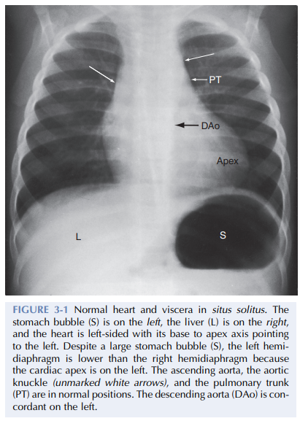
SITUS SOLITUS
Atrial situs and abdominal situs are concordant
Percussion- left-sided stomach, a right-sided liver, and a left-sided heart.
A morphologic right bronchus is relatively short and straight, whereas a morphologic left bronchus is relatively long and curved.
A morphologic right bronchus is concordant with a trilobed morphologic right lung, and a morphologic left bronchus is concordant with a bilobed morphologic left lung.
Base to apex axis points to the left
Left hemidiaphragm is normally lower than the right hemidiaphragm.

Slide 21
TYPES OF CARDIAC MALPOSITIONS
Viscero-atrial situs inversus with dextrocardia
Viscero-atrial situs solitus with dextrocardia
Viscero-atrial situs inversus with levocardia
Mesocardia, a midline heart, is sometimes regarded as a fourth malposition.

Slide 22
A midline heart in situs solitus with a d-bulboventricular loop is a variation of normal
A midline heart with visceroatrial situs inversus and an l-bulboventricular loop occurs with major congenital malformations.

Slide 23
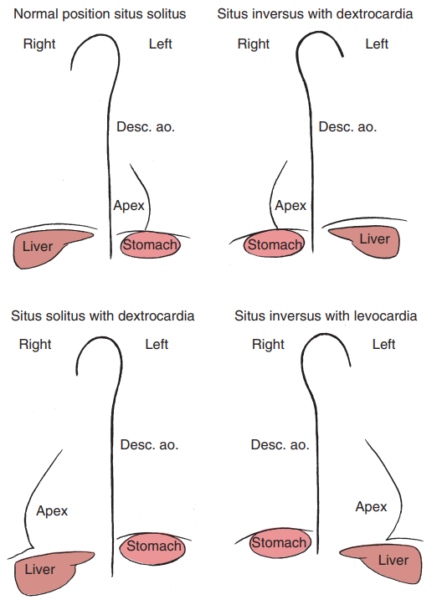

Slide 24
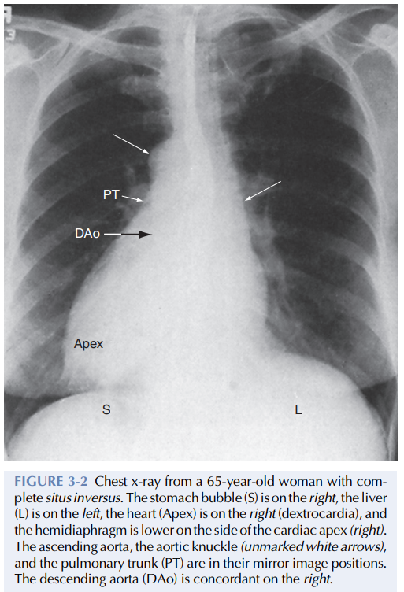
SITUS INVERSUS WITH DEXTROCARDIA
Incidence - 1/8000 to 1/25,000
The heart and the thoracic and abdominal viscera are mirror images of normal
The bronchi are inverted
Morphologic right bronchus concordant with the morphologic right atrium and the trilobed lung
Morphologic left bronchus concordant with the morphologic left atrium and the bilobed lung

Slide 25
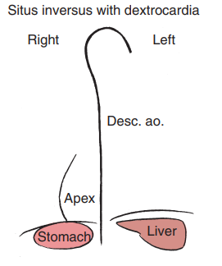
The heart is right-sided, and the right hemidiaphragm is lower than the left hemidiaphragm
The descending aorta is on the right; the ascending aorta, aortic knuckle, and pulmonary trunk are in their mirror image positions
The anatomic right ventricle lies to the left of the anatomic left ventricle (l-bulboventricular loop), which is normal for situs inversus

Slide 26
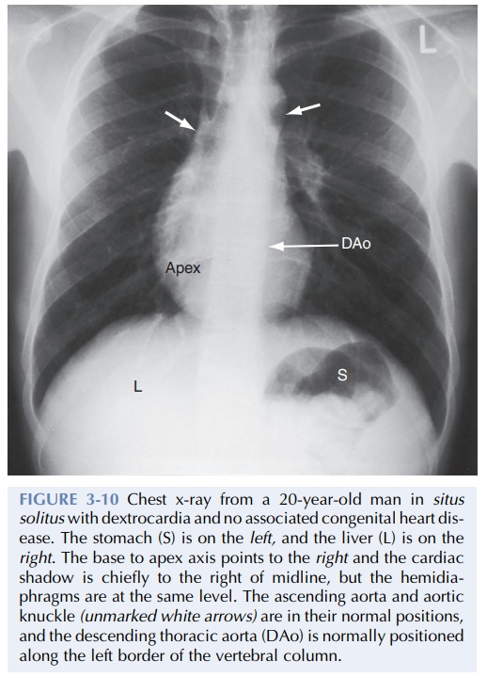
SITUS SOLITUS WITH DEXTROCARDIA
The lungs and abdominal viscera are situs solitus
The major cardiac shadow lies to the right of midline (dextrocardia)
The base to apex axis points to the right
Right hemidiaphragm is usually lower than the left hemidiaphragm

Slide 27
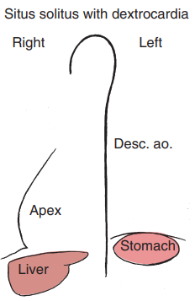
The ascending aorta and aortic knuckle occupy their normal positions and the descending aorta runs its normal course along the left vertebral border
The anatomic right ventricle lies to the right of the anatomic left ventricle (d-loop)
It is because the straight heart tube of the embryo initially bends in a rightward direction (d-loop) but then fails to pivot into the left chest
Varying degrees of incomplete pivoting determine the degree to which the ventricular portion of the heart lies to the right of midline

Slide 28
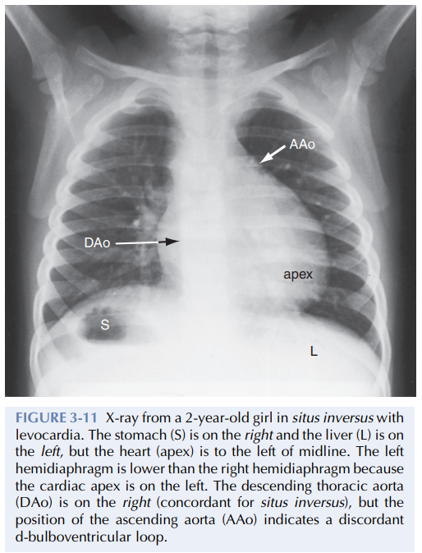
SITUS INVERSUS WITH LEVOCARDIA
Situs inversus of thoracic and abdominal viscera in the presence of a left thoracic heart (levocardia)
The left hemidiaphragm is lower than the right hemidiaphragm because the apex is on the left
Inversion of the bronchi coincides with inversion of the atria and lungs
The stomach is on the right, and the liver is on the left (abdominal situs inversus)

Slide 29
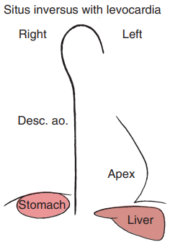
The major cardiac mass lies in the left chest for one of two morphogenetic reasons
an embryonic l-loop, which is concordant for situs inversus, fails to pivot into the right side of the chest
an embryonic d-loop, which is discordant for situs inversus, fails to pivot into the left side of the chest

Slide 30
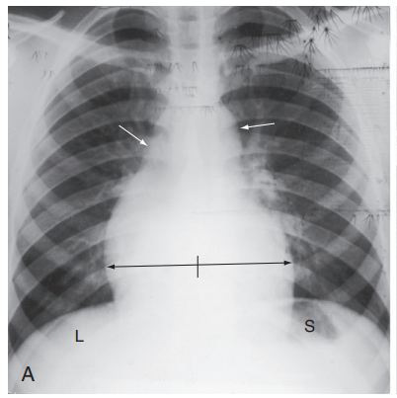
MESOCARDIA
The cardiac silhouette extends equally to the right and left of midline
A d-bulboventricular loop stops in the midline as it pivots to the left
Rarely, mesocardia is associated with situs inversus and an l-loop that stops in the midline as it incompletely pivots to the right.

Slide 31
MALPOSITIONS AND CHD
Situs inversus with dextrocardia -usually occurs without coexisting congenital heart disease
Situs solitus with dextrocardia - occasionally associated with a structurally normal heart , left-to-right shunts at atrial level or ventricular level usually coexist
Situs inversus with levocardia - consistently associated with coexisting congenital heart disease
Mesocardia with discordant bulboventricular loop – ventricular inversion

Slide 32
CHD associated with situs inversus with dextrocardia
TOF
Pulmonary atresia
Complete AV septal defect
OS ASD

Slide 33
CHD associated with situs solitus with dextrocardia
Ventricular septal defect
Left SVC to the coronary sinus
Coarctation of the aorta
secundum atrial septal defect
Anomalous pulmonary venous connections
Complete AV septal defect

Slide 34
CHD associted with Mesocardia
VA discordance with AV discordance (corrected TGA )
VA discordance without AV discordance (complete transposition of the great arteries)

Slide 35
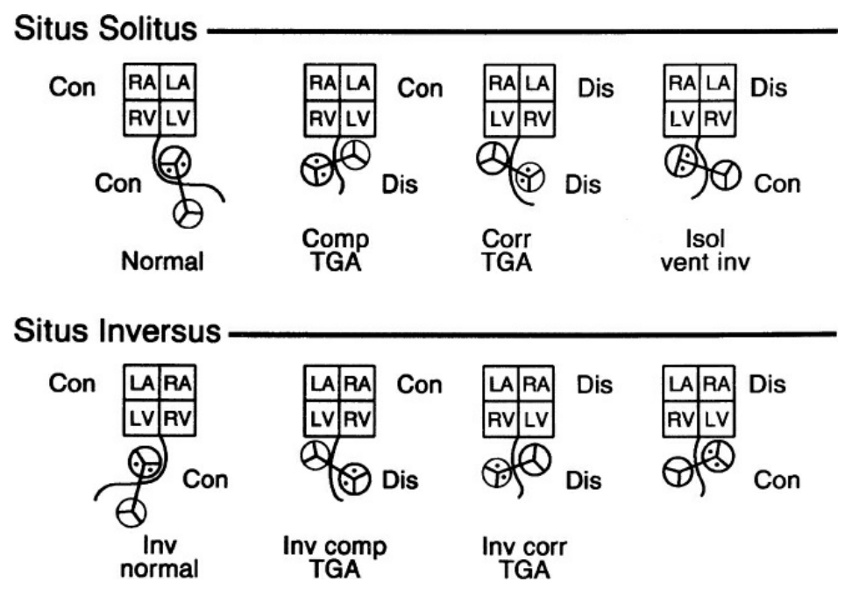

Slide 36
CLINICAL APPROACH TO CARDIAC MALPOSITIONS

Slide 37
HISTORY
Situs Inversus With Dextrocardia:
Usually normal heart with normal life span
Angina - right anterior chest with radiation to the right shoulder and right arm
Pain of appendicitis is referred to the left lower quadrant
Pain of biliary colic referred to left upper quadrant
Kartagener’s syndrome - sinusitis, bronchiectasis, situs inversus
Male infertility

Slide 38
In situs solitus with dextrocardia and situs inversus with levocardia, accomapanying congenital cardiac lesions bring the patient to medical attention

Slide 39
EXAMINATION
Physical findings of coexisting congenital heart disease are found rather than the cardiac malposition itself.
The left testicle in the healthy upright male is lower than the right testicle, whereas the opposite is the case in situs inversus
Poland’s syndrome, which is characterized by the absence of a pectoralis major muscle (usually right-sided) ipsilateral syndactyly, brachydactyly, and hypoplasia of a hand has been reported with situs solitus and dextrocardia
Goldenhar’s syndrome (oculo-auricular vertebral dysplasia, hemifacial microsomia) has been reported with complete situs inversus.

Slide 40
PALPATION AND PERCUSSION
A right anterior chest bulge with asymmetry – dextrocardia
Percussion shows right or left thoracic location of the heart and the abdominal location of hepatic dullness and gastric tympany.
If the stomach is not sufficiently air-filled to generate a tympanitic percussion note, a carbonated beverage or deliberate aerophagia (an infant can suck an empty bottle) can be used

Slide 41
Percussion begins over the sternum and then is used to compare left and right parasternal sites
The side of major cardiac dullness is more accurately established with percussion with the patient turned moderately to the left and then moderately to the right
The heart tends to fall to the side toward which the base to apex axis points

Slide 42
APICAL IMPULSE
Situs inversus with dextrocardia- morphologic LV that occupies the apex in the right hemithorax and a morphologic RV that underlies the lower right sternal border
Situs solitus with dextrocardia- a right thoracic apical lowpressure morphologic RV that retracts and a high-pressure systemic morphologic left ventricle that generates outward systolic movement adjacent to the lower right sternal border
Situs inversus with levocardia- left thoracic apical low-pressure morphologic RV that retracts and a high-pressure systemic morphologic LV that generates outward systolic movement adjacent to the lower left sternal border

Slide 43
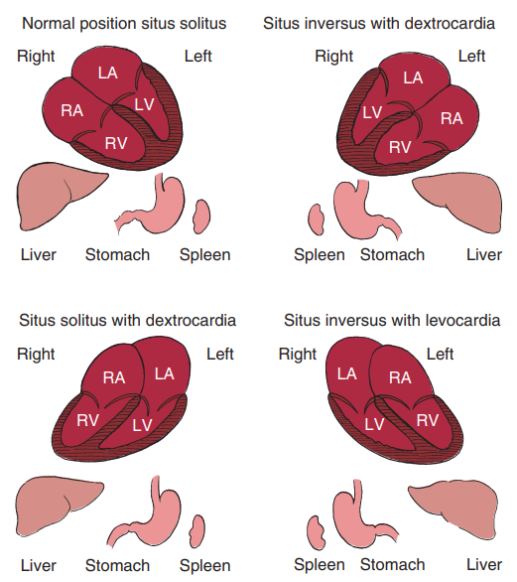

Slide 44
AUSCULTATION
The relative prominence of auscultatory events should be compared in the left and right anterior hemithorax (left and right sternal borders and at the apices)
The stethoscope should alternate from one side to the other for comparison of analogous right and left thoracic sites.
Dextrocardia - the first and second heart sounds are louder in the right anterior chest , splitting of the second sound in the second right intercostal space

Slide 45
Situs solitus with dextrocardia and a d-loop- the position of the pulmonary valve results in splitting of the second sound in the second right interspace and the anterior position of the aorta results in amplification of the aortic component
Situs inversus with levocardia- splitting of the second sound is more prominent in the second left interspace.

Slide 46
ECG
Start with P wave direction, to determine atrial situs
Look for Septal q wave in v5, v6 – to determine ventricular inversion
Look for R wave progression in precordial leads – to determine Right sided or left sided heart
Normal left-to-right septal depolarization (d-loop) results in Q waves in standard left precordial locations

Slide 47
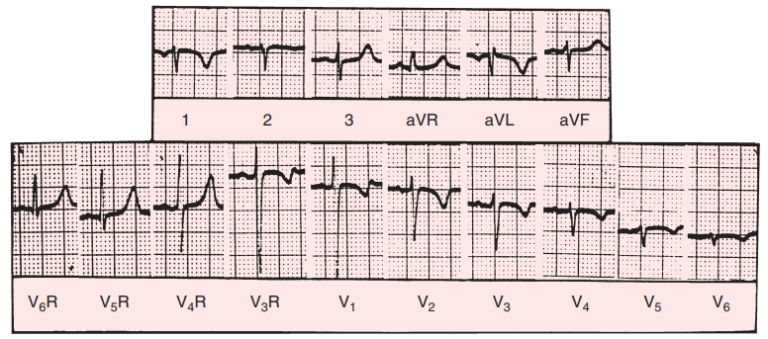
Situs inversus with either dextrocardia or levocardia, atrial depolarization proceeds from a left sinus node, so inverted P waves appear in leads 1 and aVL and an upright P wave appears in lead aVR

Slide 48
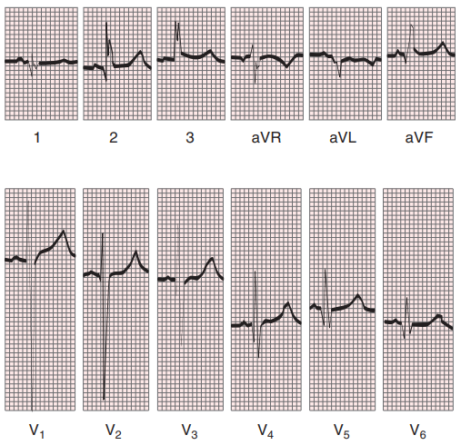
Situs solitus with dextrocardia or levocardia- right sided sinus node
Upright P waves appear in leads 1 and aVL and an inverted P wave appears in lead aVR

Slide 49
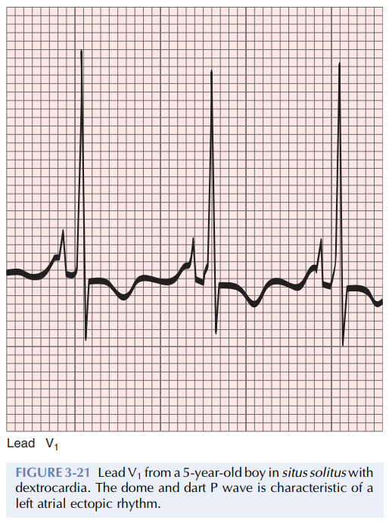
LEFT ATRIAL ECTOPIC VS LEFT SINUS NODE
A negative P wave in lead 1 or lead V1 does not distinguish situs solitus with a left atrial ectopic rhythm from situs inversus
A dome and dart P wave in lead V1 or V2 confirms a left atrial ectopic focus irrespective of atrial situs.

Slide 50
Leads placement in known cardiac malposition
Situs inversus with dextrocardia- reversed arm leads and right precordial leads mimics situs solitus ECG
Situs solitus with dextrocardia- standard arm leads and right precordial leads (since atrial situs is not changed) is preferred
Situs inversus with levocardia- standard limb lead and precordial lead positions suffice

Slide 51
CHEST X-RAY
The first thing is to identify the orienting letters L and R.
Situs determination (visceral)
Establish the cardiac axis(base-apex axis)
The relative levels of the 2 hemidiaphragms
Identify concordant bronchial morphology

Slide 52
XRAY DESIGNATION AND SITUS INVERSUS

Slide 53
SITUS INVERSUS WITH LEVOCARDIA

Slide 54
ECHOCARDIOGRAM
It aids systematic segmental analysis of visceroatrial situs, atrioventricular connections, ventricular locations, and the spatial relationships and ventricular alignments of the great arteries
Atrial morphology and situs are easier to infer from the abdominal echocardiogram.
The normal situs solitus with left thoracic heart is represented by an aorta on the left side of the spinal column and an inferior cava on the right side of the spinal column
The morphologic right atrium resides on the same side as the inferior vena cava (atrial situs solitus)
The inferior vena cava and aorta are distinguished from each other with color flow imaging because the aorta pulsates

Slide 55
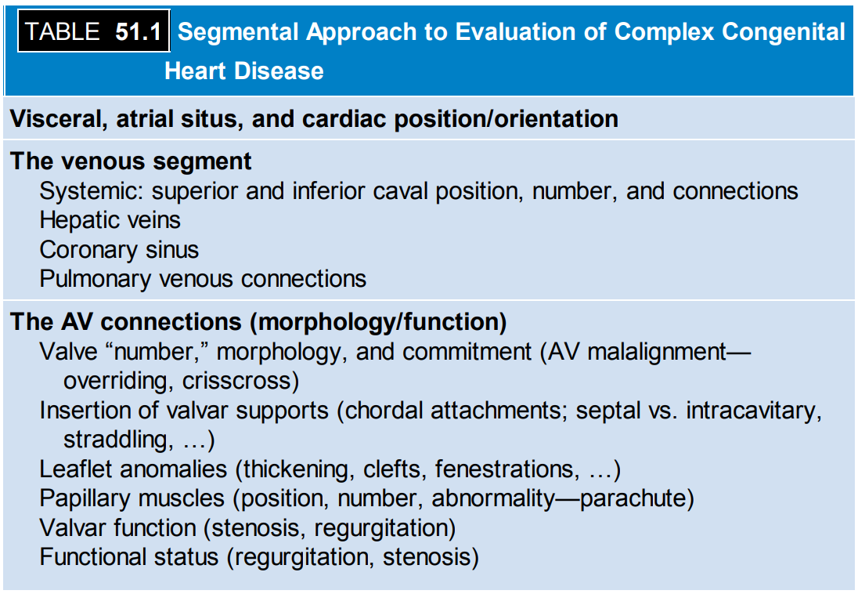

Slide 57
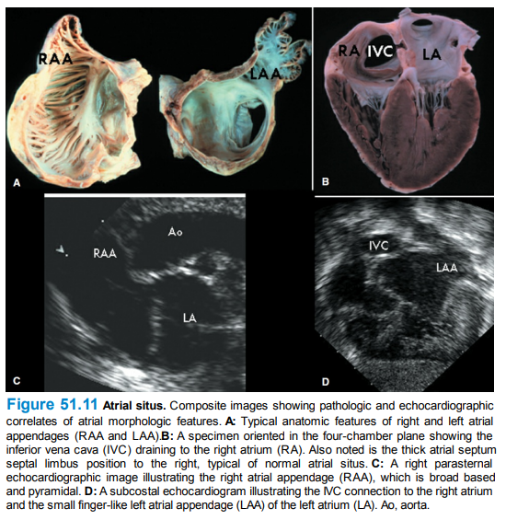

Slide 58
SITUS SOLITUS

Slide 59
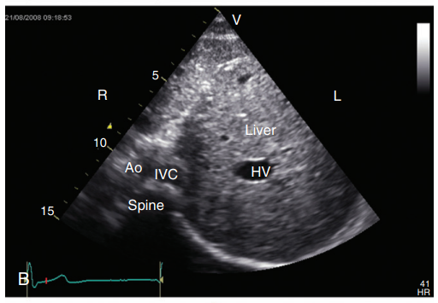
SITUS INVERSUS

Slide 62
VISCERAL HETEROTAXY
Visceral heterotaxy occurs in 0.8% of cases of congenital heart disease.
Right and left bronchi are normally asymmetric, the right lung is trilobed, the left lung is bilobed, and the right and left atrial appendages are morphologically distinctive.

Slide 63
The spleen is the only organ that is normally left-sided from its inception because it develops in the left side of the dorsal mesogastrium
Unpaired structures such as the liver, spleen, and stomach are normally confined to either the right or left upper quadrant of the abdomen
The two bronchi can be morphologically right or morphologically left, the two lungs can be bilaterally trilobed or bilaterally bilobed and the two atrial appendages can exhibit right or left morphologic features

Slide 64
Visceral heterotaxy with right isomerism
It usually comes to light because of complex cyanotic congenital heart disease or because of the septicemia associated with asplenia.
Howell-Jolly bodies on peripheral blood smears after the first week of life are evidence of asplenia.
Palpation of a transabdominal liver edge in a cyanotic neonate or infant implies visceral heterotaxy but not its type.
Sinoatrial nodes are bilateral, but the right sinus node is usually dominant so the P wave axis is normal.

Slide 65
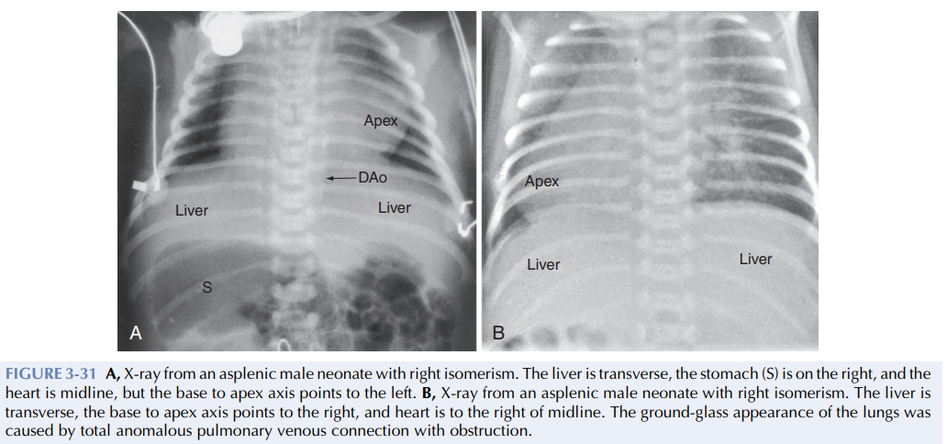
The x-ray confirms the transverse liver and may disclose bilaterally symmetric morphologic right bronchi

Slide 66
Abdominal echocardiography visualizes a transverse liver but no spleen.
The aorta and inferior vena cava are anterior to or on the same side of the spinal column, and the inferior vena cava joins the right-sided atrium after receiving the hepatic veins

Slide 67
RIGHT ISOMERISM
Bilateral superior vena cavae
Bilateral sinoatrial nodes
Paired atrioventricular nodes
Bilateral morphologic right atria (appendages)
Bilateral morphologic right bronchi
Bilateral morphologic right lungs
Dextrocardia or levocardia
Asplenia
Transverse liver Right-sided or left-sided stomach

Slide 68
CONGENITAL CARDIAC MALFORMATIONS WITH RIGHT ISOMERISM
Common atrium
Common atrioventricular valve
Morphologic or functional single ventricle
Pulmonary stenosis or atresia
Total anomalous pulmonary venous connection
Absent coronary sinus

Slide 69
VISCERAL HETEROTAXY WITH LEFT ISOMERISM
It presents in an acyanotic infant with congestive heart failure because a left-to-right shunt exists without obstruction to right ventricular outflow
Physical examination discloses a transverse liver and a left-sided heart.
The x-ray confirms the transverse liver and reveals bilaterally symmetric morphologic left bronchi.
A distinctive radiologic feature is inferior vena caval interruption with azygous continuation.

Slide 70
ECG discloses the abnormal P wave axis of an ectopic atrial pacemaker because the sinus node is absent
The diagnostic findings are abnormal P wave axis, complete atrioventricular block, and narrow QRS complexes
Abdominal echocardiography is used to confirm the transverse liver and identify an inferior vena cava and aorta anterior to or on the same side of the spinal column
When the inferior cava is interrupted, hepatic veins do not join the caval vein but instead connect to the atria

Slide 71
LEFT ISOMERISM
Bilateral superior vena cavae
Bilateral morphologic left atria (appendages)
Absent or atretic sinoatrial node
Bilateral morphologic left bronchi
Bilateral morphologic left lungs
Transverse liver
Polysplenia
Stomach usually right-sided

Slide 72
CONGENITAL CARDIAC MALFORMATIONS WITH LEFT ISOMERISM
Levocardia, less frequently dextrocardia
Common atrium
Inferior vena caval interruption with azygous continuation
Partial anomalous pulmonary venous connection
Two atrioventricular valves or common atrioventricular valve
Atrioventricular septal defect Ventriculo/great arterial concordance
Left ventricular outflow obstruction

Slide 73
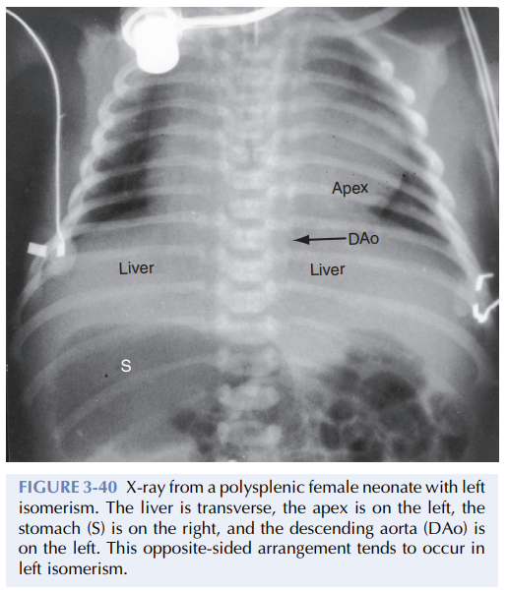

Slide 75
TREATMENT
Treatment of a wide variety of congenital cardiac malformations associated with cardiac malpositions must depend on the specific lesions encountered.
Surgical correction should be achieved as frequently as possible as frequently as possible using a two ventricle repair; such as
Variations of the arterial switch procedure (Jatene, Kaye–Damus–Stansel, or Aubert procedures),
VSD closure connecting the systemic ventricle to the aorta (interventricular baffle),
Transection of the pulmonary artery, and establishment of pulmonary ventricle–to–pulmonary artery continuity with an extracardiac conduit (Rastelli-type corrections),
More complex procedures involving translocation of the great arteries (Nikaidoh, or Ross-Konno operations)

Slide 76
TIME FOR MCQ
58 year old male, smoker, admitted with chest pain for 8hours duration.
ECG taken

Slide 77
MCQ
ATRIAL SITUS?
VENTRICULAR RELATION?

Slide 78
ATRIAL SITUS?
VENTRICULAR RELATION?
IRA?

